Slide 1
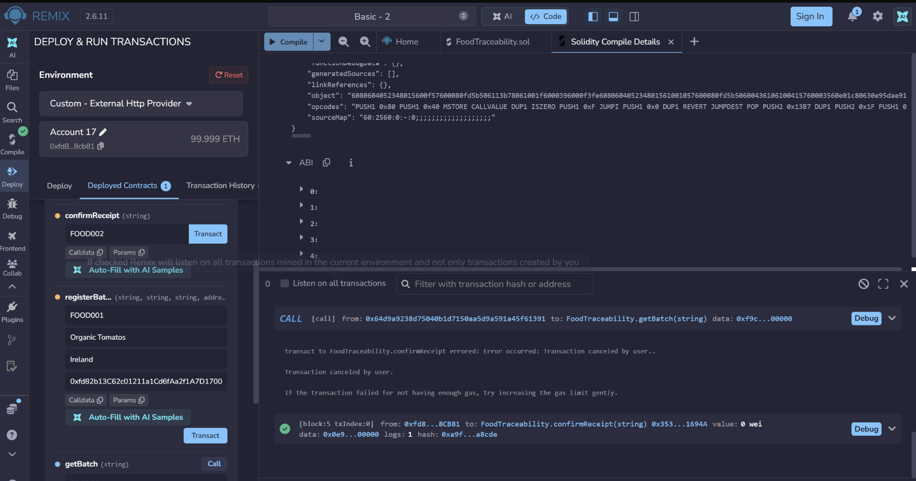
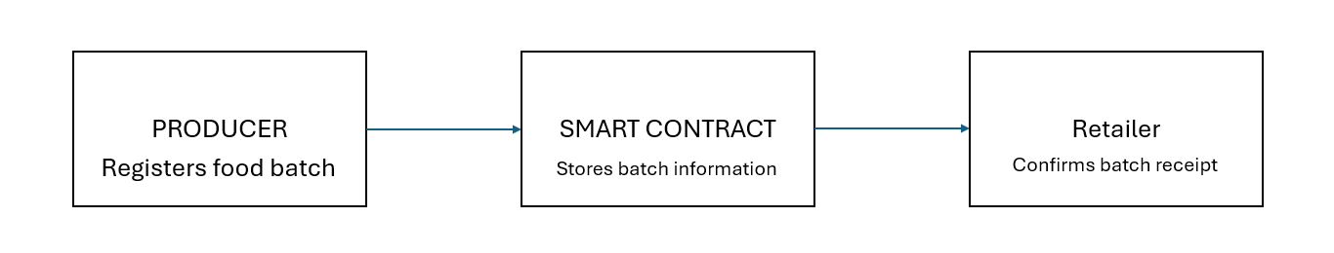
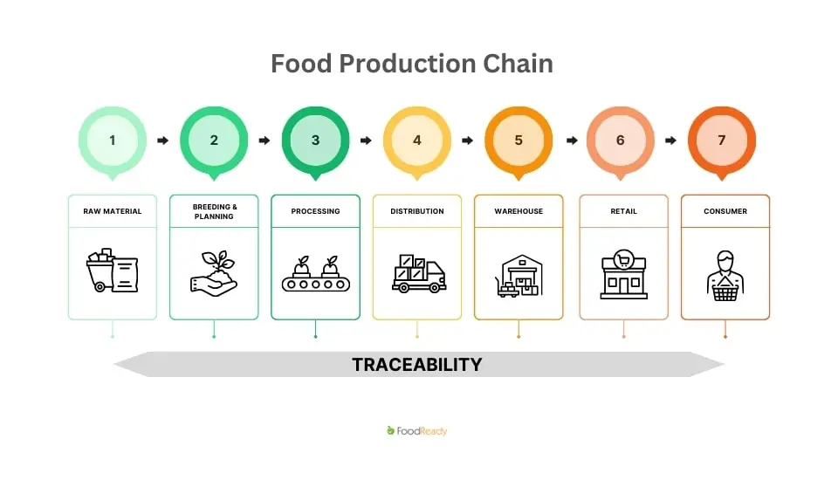
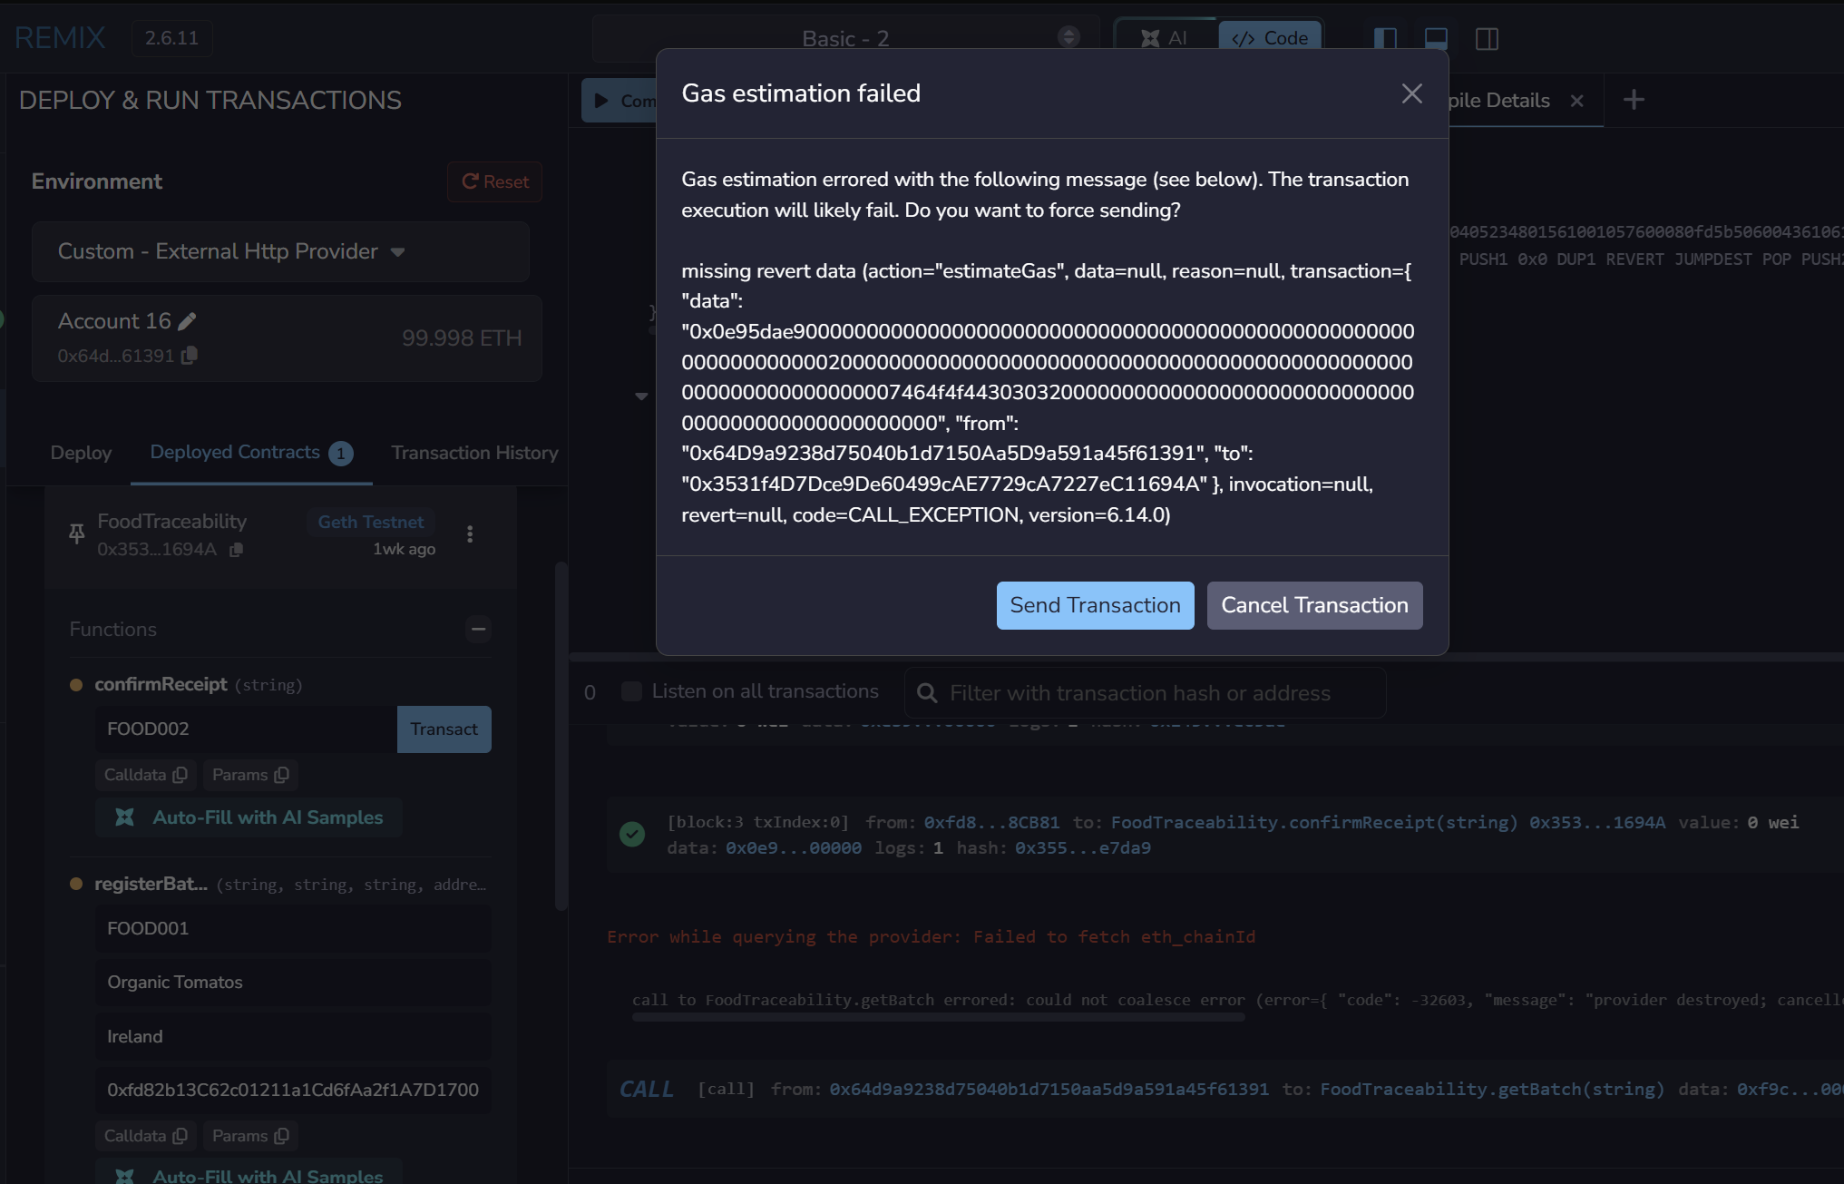
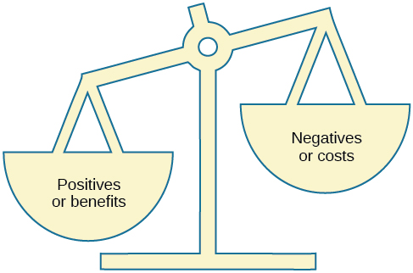
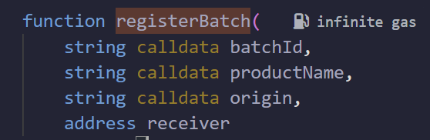
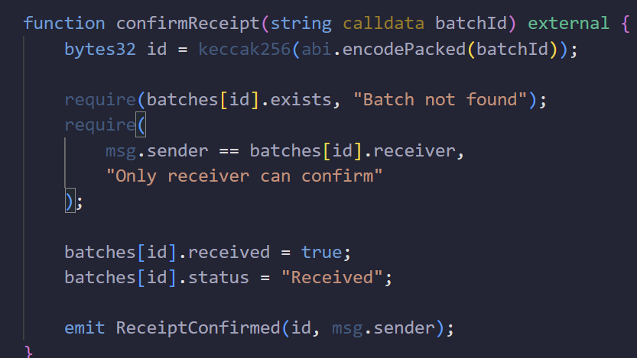
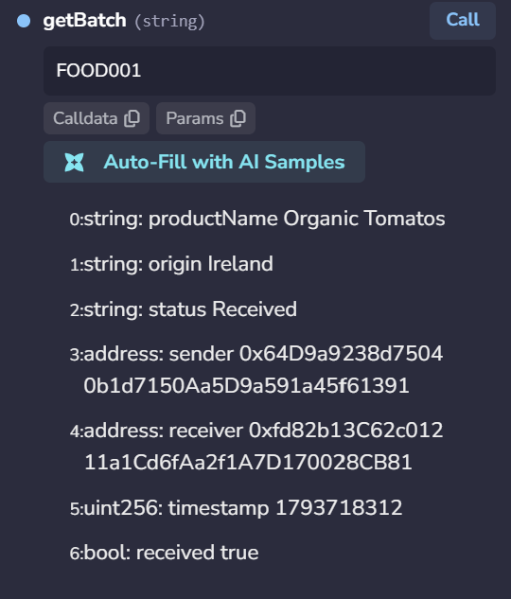

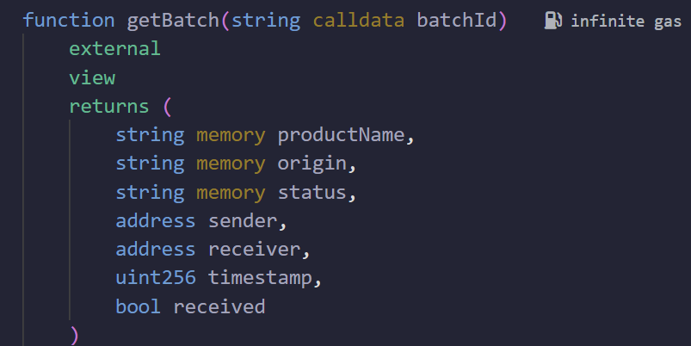
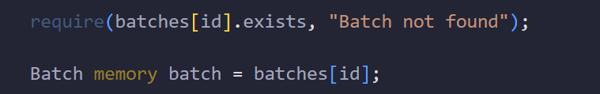
Blockchain-based food traceability system
2024348 - Victor Beny de Azevedo Cortez, CCT College Dublin
ABSTRACT
SYSTEM ARCHITECTURE
TESTING AND RESULTS
DISRUPTIVE IMPACT
It is noticeable that food supply chains contains several participants, which makes the product origin and transfer records verification difficult. Knowing that, this project presents a blockchain-based food traceability system built using a Solidity smart contract applied on a local blockchain with Ganashe. In this project, a producer registers a batch with its product name, origin and retailer’s address. After, only the retailer can confirm the receipt. The contract was tested using RemixIDE.
This system uses a smart contract built with Solidity, deployed on a local blockchain with Ganashe.
The producer is responsible for registering a food batch, providing its ID, product name, origin and retailer’s address. The smart contract then records the information and includes sender, receiver and the timestamp.
The retailer confirms the receipt of the batch. Before that, the contract checks the retailer’s address before allowing the confirmation. By using the getBatch() function, the information of the batch can be obtained.
The smart contract in this project was tested using two different food batches, with them being FOOD001 (Organic tomatoes) and FOOD002 (Organic apples).
The test performed demonstrated that:
The producer was able to register a batch.
The specified retailer was able to confirm receipt.
An unauthorized confirmation attempt is rejected.
The getBatch() function can be used to obtain the batch information.
Blockchain changes how food traceability information is shared and stored. The traditional supply chains often rely on information that is maintained by separate organizations, which makes its verification harder. (DNV, 2025)
By using blockchain, the product movements and information verification are simplified, improving the audit trail reliability (Stranieri et al., 2020).
PROBLEM STATEMENT
BENEFITS AND CHALLENGES
Food supply chains are composed by a high number of participants, being them producers, distributors and retailers (DNV, 2025). As the food products move participants, information regarding their origin and handling must be recorded in order to ensure food safety. However, in some cases the records might be spread between different systems, which makes tracking harder.
Considering that, food traceability shows its importance by improving the identification of product’s origin and movement. In this case, the blockchain technology proposes an solution by providing a shared record of transactions (Dock, 2024).
Benefits:
Batch information is recorded on a shared blockchain ledger
Only the specified retailer can confirm receipt
Transact records can be verified
The system allows more identification of batch movements
Challenges:
Incorrect information entered by participants cannot be detected automatically.
The adoption of the system would require integration with other existent business systems.
SMART CONTRACT IMPLEMENTATION
In this project, the FoodTraceability smart contract was developed using Solidity and deployed on Ganashe.
It includes three main functions, being:
registerBatch(): it allows the producer to register a food batch, including ID, product name. origin and retailer’s address.
confirmReceipt(): Allows only the specified retailer to confirm receipt, updating the status to “received”.
getBatch(): Used to obtain the stored information about a batch.
Additionally, the contract uses msg.sender variable to identify the sender and the require() function to improve the restriction by checking for specific requirements before allowing a operation.
OBJECTIVES
CONCLUSIONS
The main goals of this project are to:
Develop a smart contract used to register and track food batches.
Allow the producers to record product information, allowing the retailers to be identified.
Make sure that only the specified retailer can confirm the receipt
Store the transaction records on a local blockchain
Show information retrieval and status using RemixIDE.
This project showed how the blockchain technology is able to improve food traceability by using a Solidity smart contract.
The system has successfully registered food batches and allowed the authorized retailers to confirm receipts, while restricting the unauthorized ones.
Finally, the results demonstrate that the system can improve record transparency and verification. However, additional development would be required for an real-world implementation.
BUSINESS MODEL
The solution proposed in this project is a Business-to-Business model, which provides the food traceability services for producers, retailers and distributors. (Chen, 2024)
It is valuable because it allows different participants to participate in the food batch registration, sharing and verification process through the blockchain system. Previous research involving three agri-food supply chains found that there were improvements in information sharing and profitability. (Stranieri et al., 2020)
The model could be used by food business in order to improve traceability and information transparency.
REFERENCES
Chen, J. (2024). Business to Business (B2B). [online] Investopedia. Available at: https://www.investopedia.com/terms/b/btob.asp [Accessed 13 Nov. 2026].
DNV. (2025). Food supply chain: A comprehensive guide | DNV. [online] Available at: https://www.dnv.com/assurance/food-and-beverage/food-supply-chain-stages-models-and-practices/ [Accessed 13 Nov. 2026].
Dock (2024). Blockchain food traceability: Enhancing transparency and safety. [online] www.dock.io. Available at: https://www.dock.io/post/blockchain-food-traceability [Accessed 13 Nov. 2026].
Stranieri, S., Riccardi, F., Meuwissen, M.P.M. and Soregaroli, C. (2020). Exploring the impact of blockchain on the performance of agri-food supply chains. Food Control, 119, p.107495. doi:10.1016/j.foodcont.2020.107495.

